Slide 1
DECISION-BASeD ADVERSARIAL ATTACK
----- HAO YUN

Slide 2

OVERVIEW
INTRODUCTION
BOUNDARY ATTACK
TECHNICAL LOGIC
COMPARISON WITH OTHER ATTACKS
GRADIENT-BASED ATTACK
DISCUSSION

Slide 3

Boundary attack
DESCISION-BASED ATTACK
ADVERSARIAL ATTACK
BLACK-BOX ATTACK

Slide 4
Threat scenario
Aim to change the decision of a model (either untargeted or targeted)
The adversary can observe the final decision of the model of arbitrary inputs
The adversary knows at least one perturbation, however large, for which the perturbed sample is adversarial

Slide 5
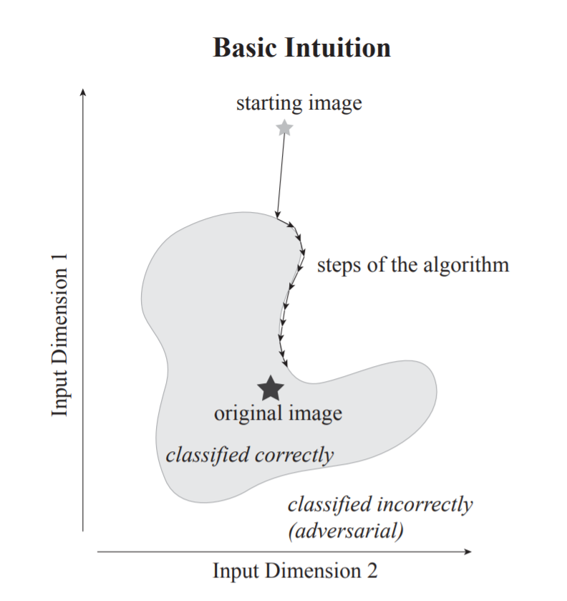

ALGORITHM

Slide 6
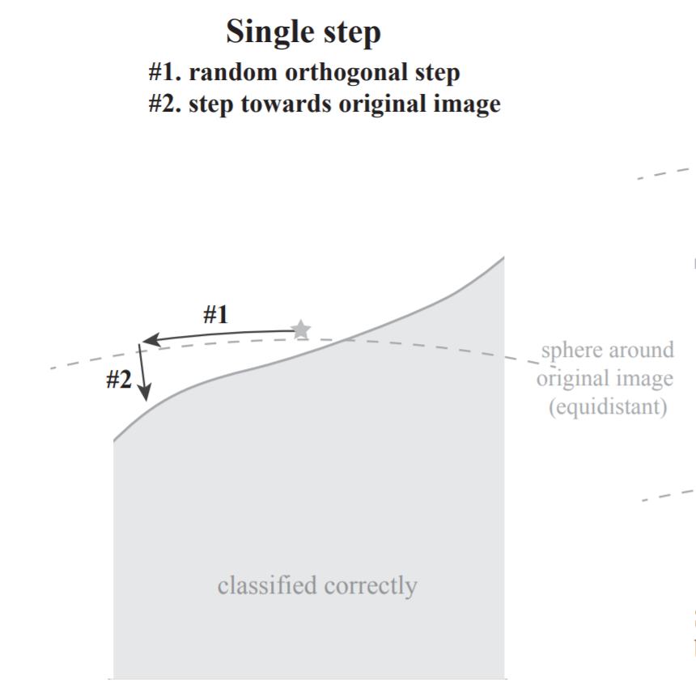
ALGORITHM

Slide 7
Comparison
Gradient-Based Attacks
Datasets
Fast-Gradient Sign Methods (FGSM)
DeepFool
Carlini & Wagner
MNIST
CIFAR-10
ImageNet-1000

Slide 8
UNTARGETED SETTING
Attack | Attack Type | Information | Performance | Run Time | Applicability
Boundary | Decision-based | Final Decision | Competitive | More Iterations | Easy & Flexible
FGSM | Gradient-based | Detailed Model Information | Competitive | - | Low
DeepFool | Gradient-based | Detailed Model Information | Competitive | Less Iterations | Low
Carlini & Wagner | Gradient-based | Detailed Model Information | Competitive | Less Iterations | Low

Slide 9
Targeted setting
Attack | Attack Type | Information | Performance | Run Time | Applicability
Boundary | Decision-based | Final Decision | Competitive | More Iterations | Easy & Flexible
Carlini & Wagner | Gradient-based | Detailed Model Information | Competitive (better) | Less Iterations | Low

Slide 10
DEFENCES Setting
Attack | Attack Type | Information | Undistilled Network | Distilled Network
Boundary | Decision-based | Final Decision | Competitive (better) | Fairly Similar as Undistilled one
FGSM | Gradient-based | Detailed Model Information | Competitive | Fails

Slide 11
DISCUSSION
Vital importance of Boundary Attack
Assess the robustness of models
Reflect weak and brittle information processing
Defense

